Slide 1
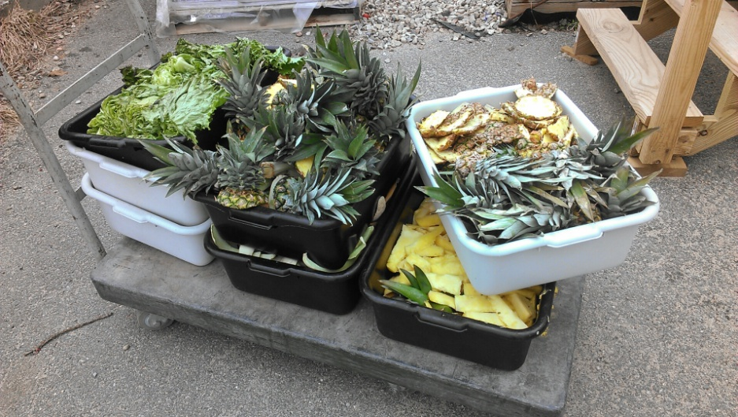
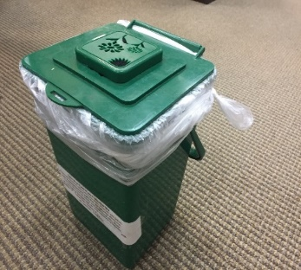
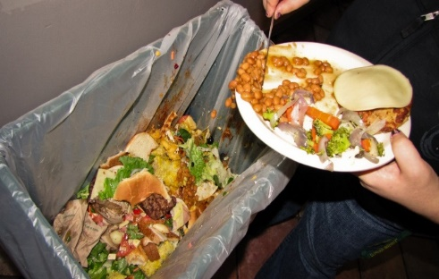
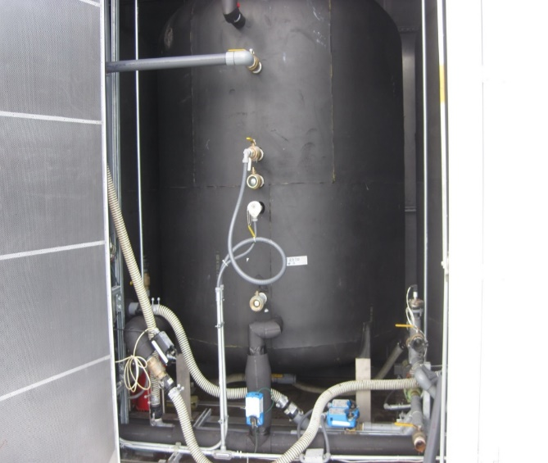
Yikes! We’ve run out of space
Help move the campus anaerobic digester to manage Food Waste
Sustainability Fund Candidate - 2020
Improve the anaerobic digester system and institutionalize a campus-wide food waste management plan that includes collection, transport to the anaerobic digester, increased reliability of the digester and biogas utilization. (Project Leads: Prof. Stefan Grimberg, and FAS Director Ian Hazen)
Benefits:
Increase FW to digester to improve operation
Improve the reliability and resilience of the digester
Continue to use the system for research & education
Reduce solid waste to the landfill
Use biogas effectively for heat
Potential Tasks for AD volunteers:
Design building renovation with AD system components
Evaluate and re-design control system components
Conduct a waste audit to identify source and rates & generation of digestable materials
Develop a cost estimate for project initiation and longer-term O&M
Develop an education and outreach campaign
Present plans to the Clarkson community
Pre-consumer
(kitchen waste)
Apartment and office FW
Post-consumer food waste
???

Slide 2
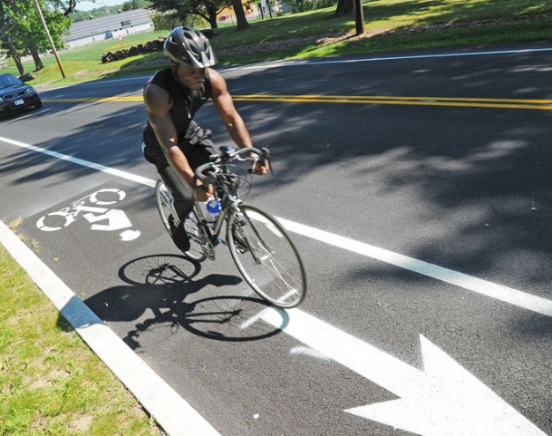
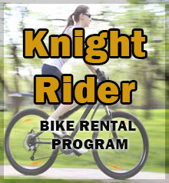
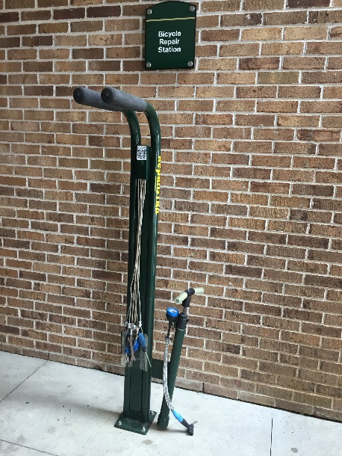
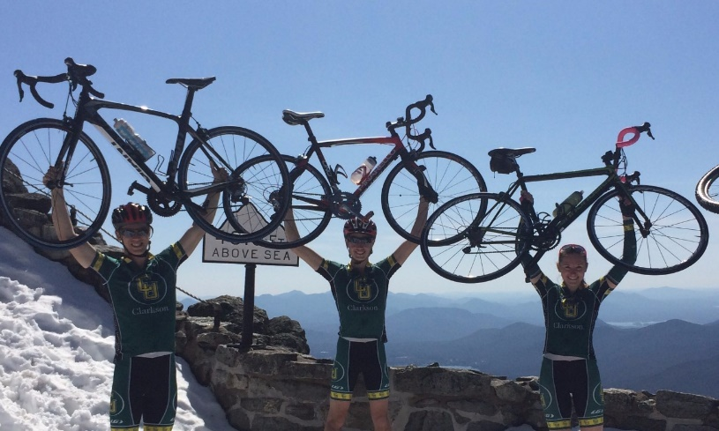
Bike Culture / Infrastructure Improvements
Improve campus bicycling infrastructure and bike-friendly attributes .
(Project leads: Prof. Backus and Campus Safety and Security Director Dave Delisle)
Sustainability Fund Candidate - 2020
The need for bicycle-friendly campus:
Encourage students to bring bikes to campus for recreation and transportation
Increase bicycling commuting, heathy lifestyle
Reduced emissions from short car trips
Potential tasks for bike infrastructure project/team:
Survey the Clarkson community to assess needs (all campuses!)
Research/field trips to explore options to meet the community needs (e.g., bike parking, community bike lanes, bike sharing program, winter storage etc.)
Identify needs/locations and implement projects/components (bike shelters/racks, new infrastructure, signage, trail changes, etc.)
Develop management plan (including cost estimates for project initiation and longer-term operations); Bike Friendly Univ. (https://www.bikeleague.org/university)
Develop an education/outreach campaign; Present plans to the Clarkson community
Prior Sustainability Fund Projects already making a difference

Slide 3
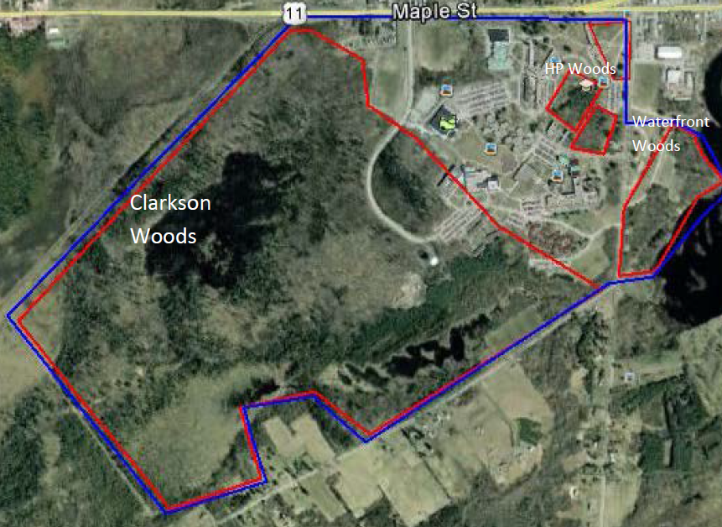
Sustainably manage Clarkson’s Natural Spaces (Project leads: Prof. Langen, CUOC, Sust. Coordinator Alex French)
Sustainability Fund Candidate - 2020
Potential opportunities for faculty/staff/student teams:
Investigate and implement sustainable standards & management plans for landscaped and forested natural areas
Develop/implement maps, kiosks, signage for trails and unique attributes
Improve trail systems
Invasive species mitigation
Inventory trees, plants and wildlife
Restore the “brown spot” along the Munter Trail
Beautify / rewild the campus
Explore use of forested areas for increased carbon sequestration and carbon accounting
Benefits
Identify a common land ethic and aesthetic for the campus community
Improve use of campus for low-impact recreation opportunities
Improve long term biodiversity on campus
The DEC has warned that if left alone our forest will lose its diversity
Uganda Microfinance Project

